Slide 1
BY HERBER
START

Slide 2
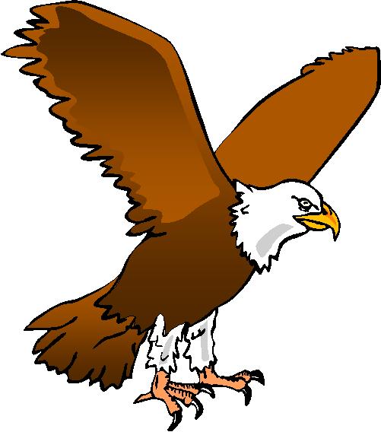
What animal is this?
This is an …
owl
owl
eagle
parakeet
turkey
parakeet
turkey

Slide 3
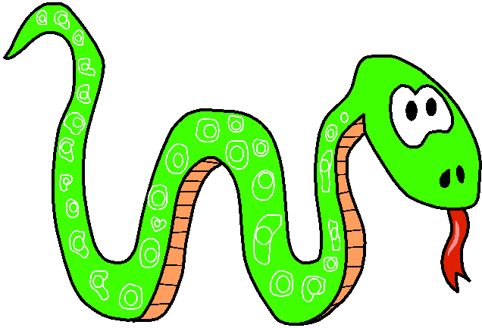
What animal is this?
This is a …
fish
shark
fish
shark
snake
frog
frog

Slide 4
What animal is this?
This is a …
dragonfly
fly
dragonfly
fly
ladybird
ladybird
butterfly

Slide 5
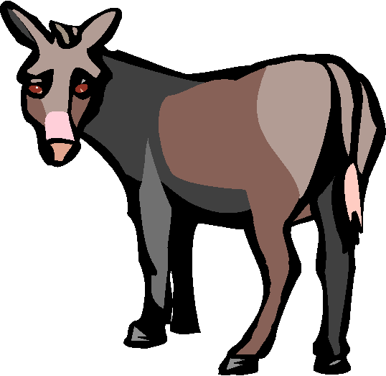
What animal is this?
This is a …
monkey
monkey
zebra
zebra
horse
donkey
horse

Slide 6
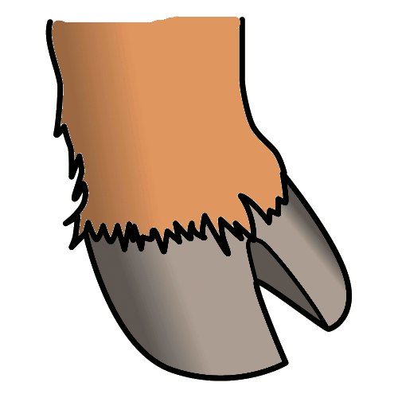
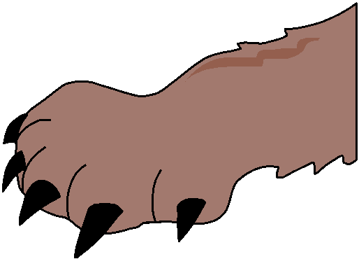
Click on the right picture
hoof

Slide 7
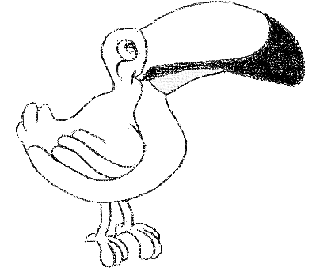
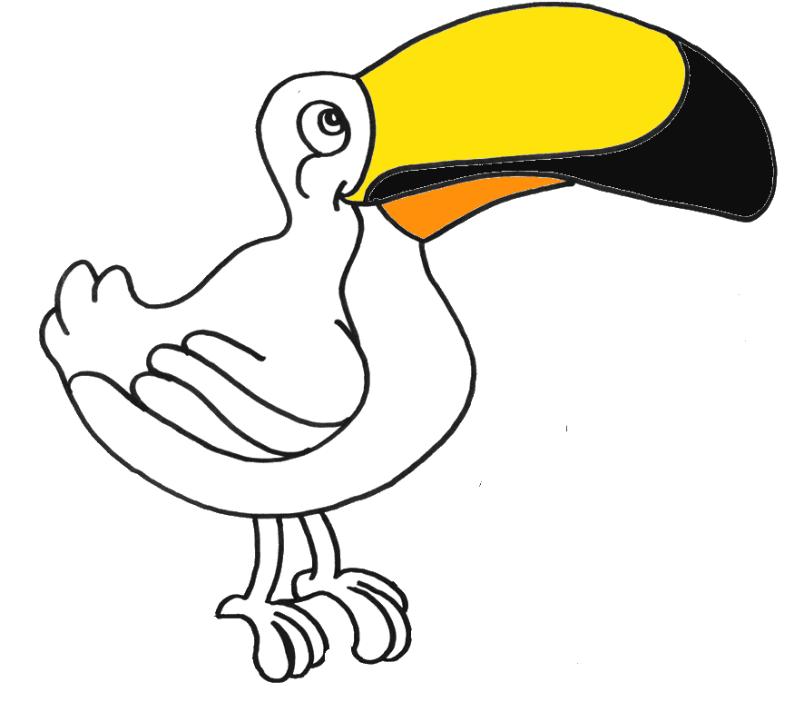
Click on the right picture
wing

Slide 8
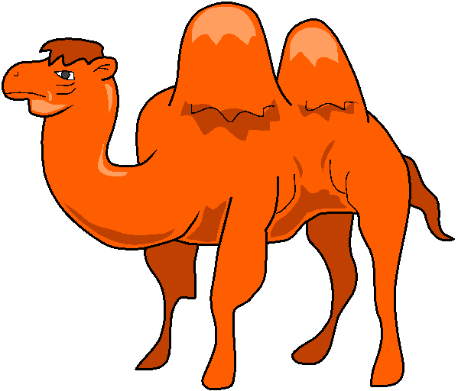
What animal is this?
It’s a camel
CHECK

Slide 9
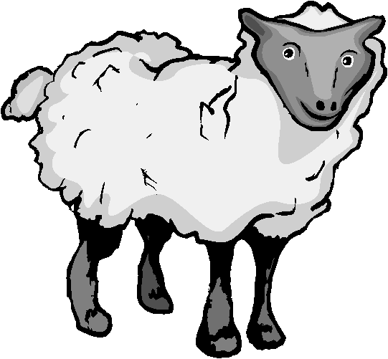
What animal is this?
It’s a sheep
CHECK

Slide 10
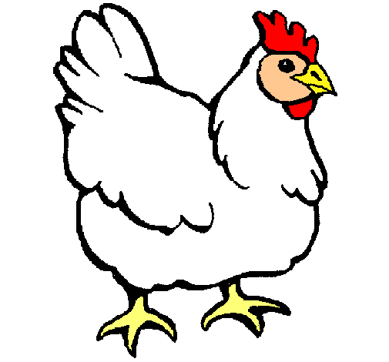
What animal is this?
It’s a hen
CHECK

Slide 11
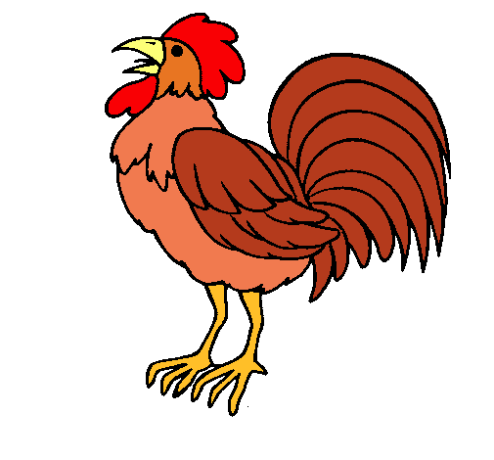
What animal is this?
It’s a rooster
CHECK

Slide 12
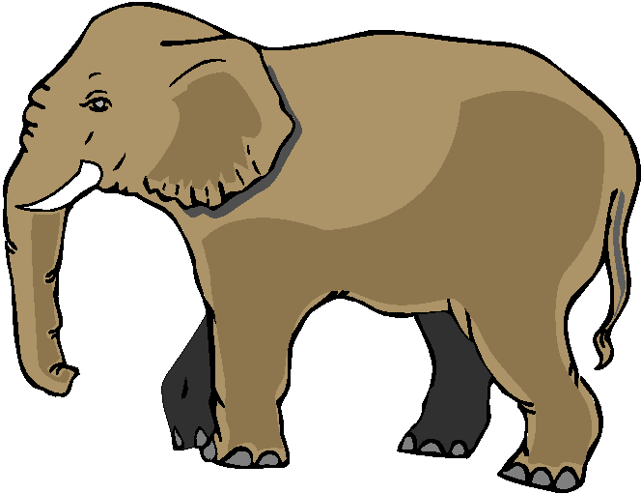
What animal is this?
It’s an elephant
CHECK

Slide 13
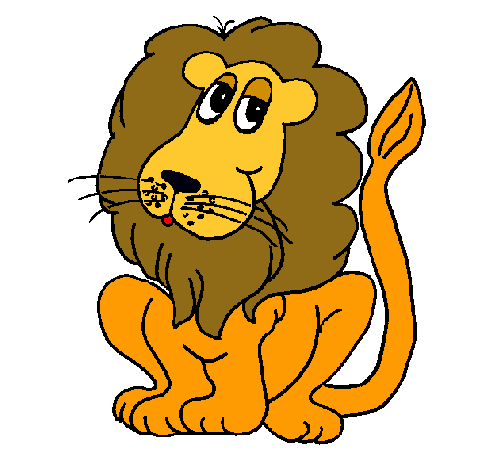
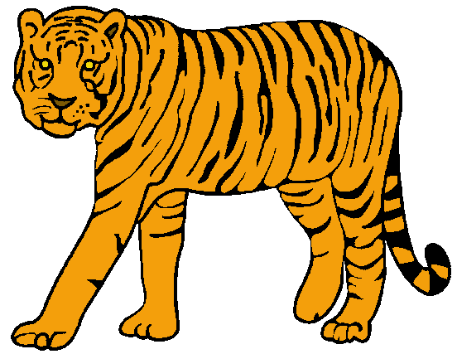
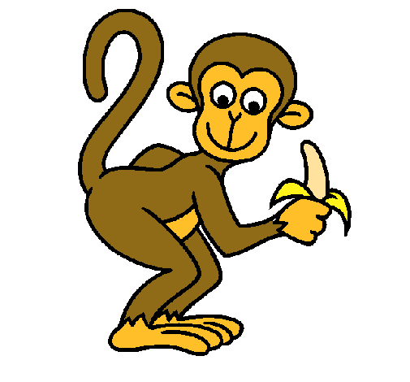
Click on the five wild animals in the list.

Slide 14
How many animals can you see here?
What are they?
TIME’S UP
CHECK
2
3
1
5
4
9
6
7
10
8

Slide 15
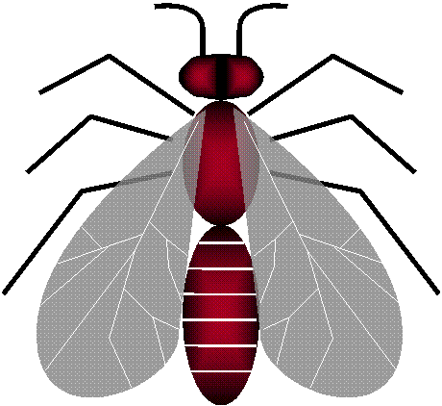
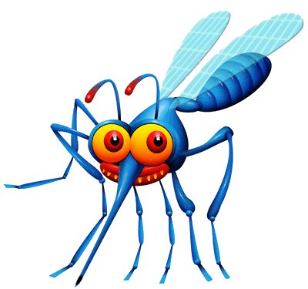
Catch the BEE

Slide 16
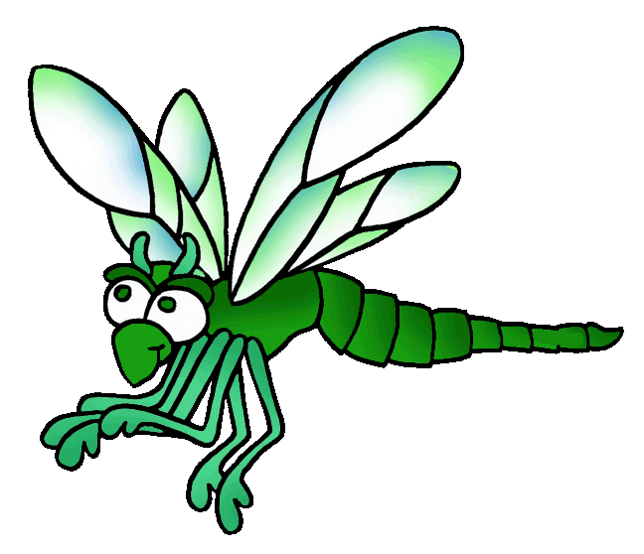
Catch the FLY

Slide 17
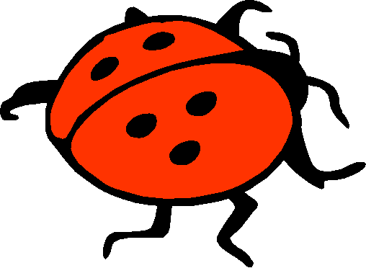
Catch the BEETLE

Slide 18
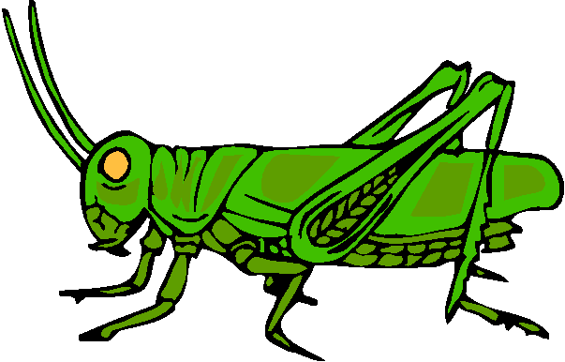
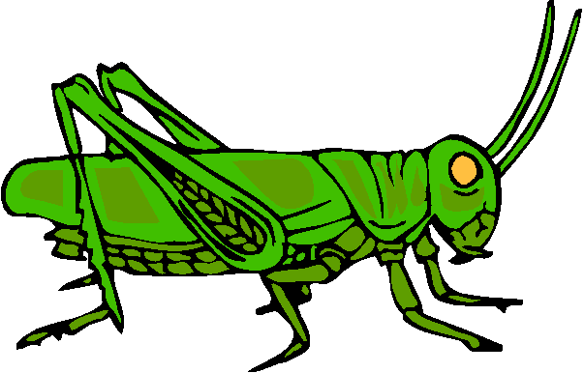
Catch the GRASSHOPPER

Slide 19
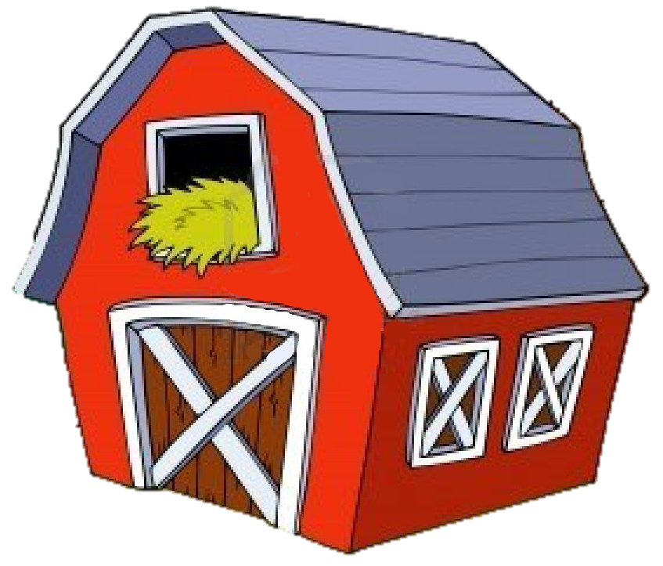
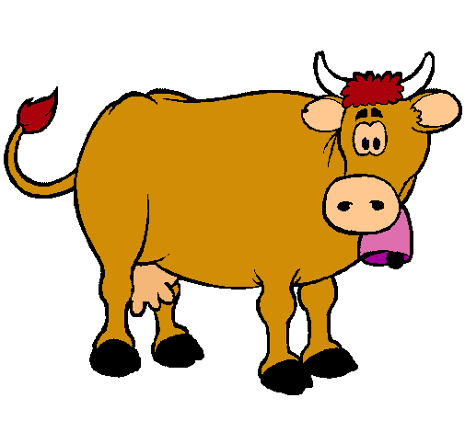
Click on the speaker and guess the animal
a cow
a goat
a duck

Slide 20
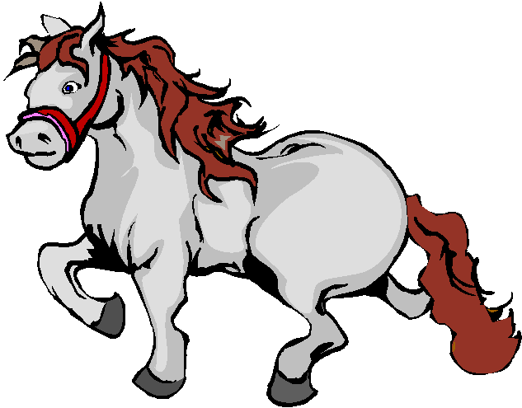
Click on the speaker and guess the animal
a goat
a donkey
a horse

Slide 21
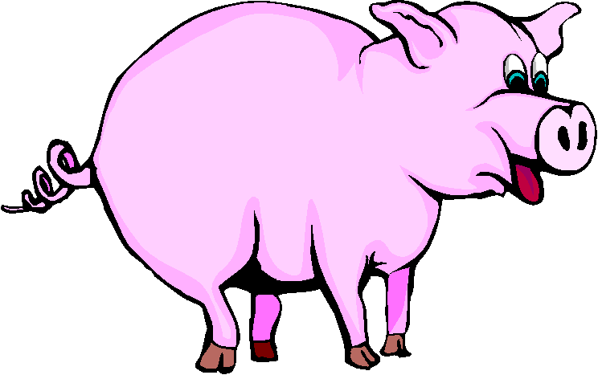
Click on the speaker and guess the animal
a duck
a pig
a hen

Slide 22
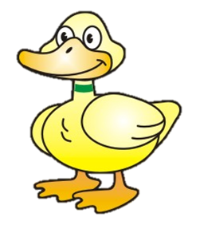
Click on the speaker and guess the animal
a duck
a turkey
a hen

Slide 23
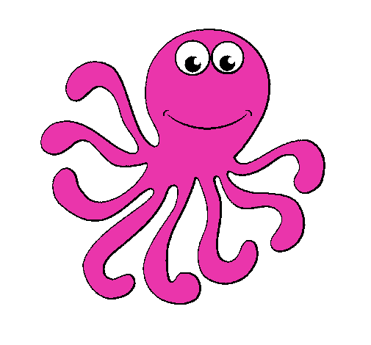
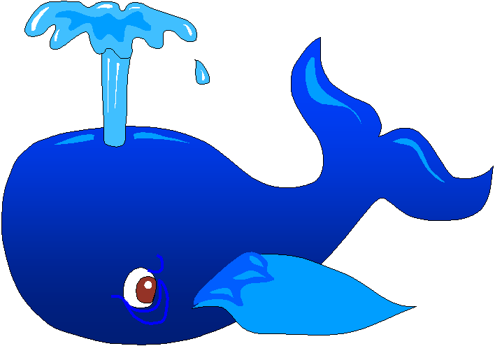
Catch the octopus

Slide 24
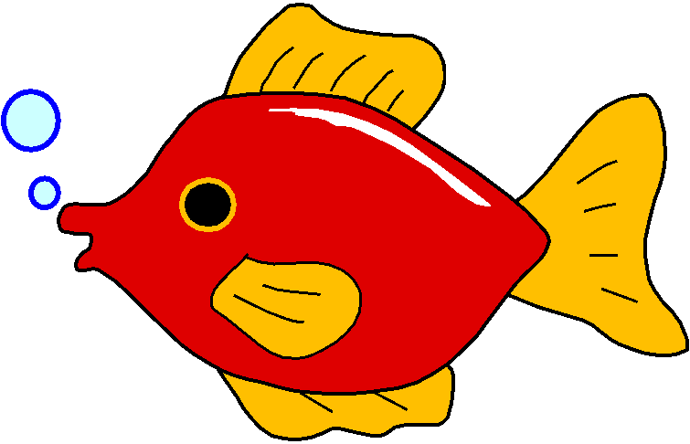
Catch the dolphin

Slide 25
Catch the goldfish

Slide 26
Catch the shark

