Slide 1
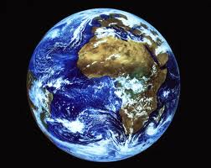
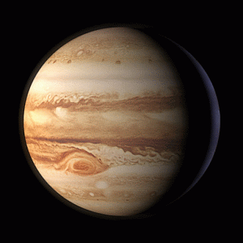
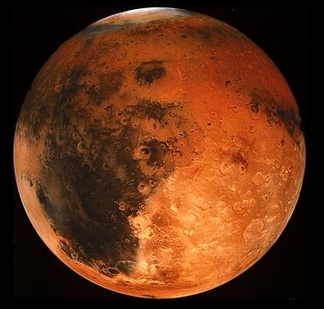
Comparatives and Superlatives

Slide 2
Jupiter is bigger than Mars.
_______

Slide 3
Mars is colder than Earth.
______

Slide 4
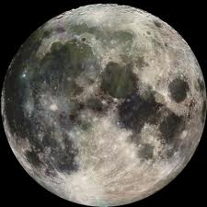
The Moon is smaller than Earth.
_______

Slide 5
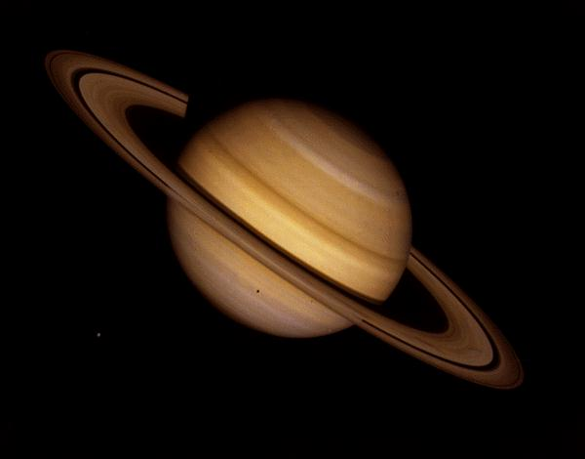
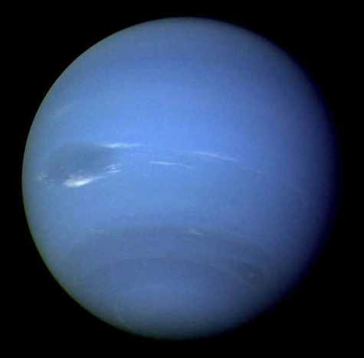
______
Saturn is closer to the Sun than Neptune.

Slide 6
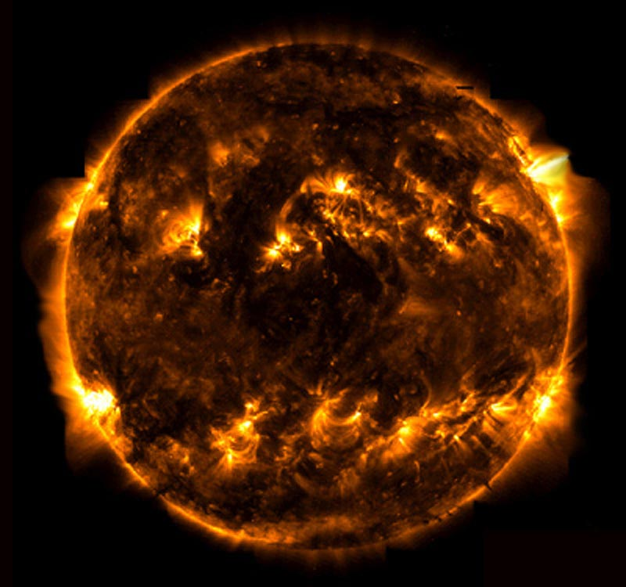
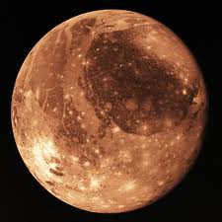
Mercury is the closest planet to the Sun.
______

Slide 7
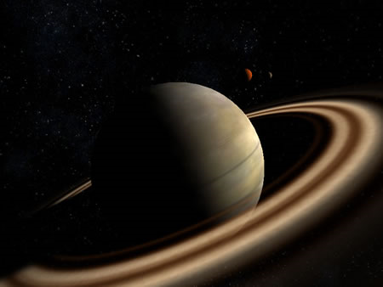
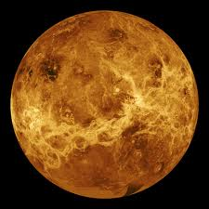
Venus is hotter than Uranus.
______

Slide 8
The Sun is the hottest star in the Solar System.
_______

Slide 9
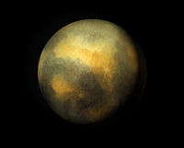
Pluto is the farthest planet from the Sun.
_______

Slide 10
Mercury is the smallest planet in the Solar System.
________

Slide 11
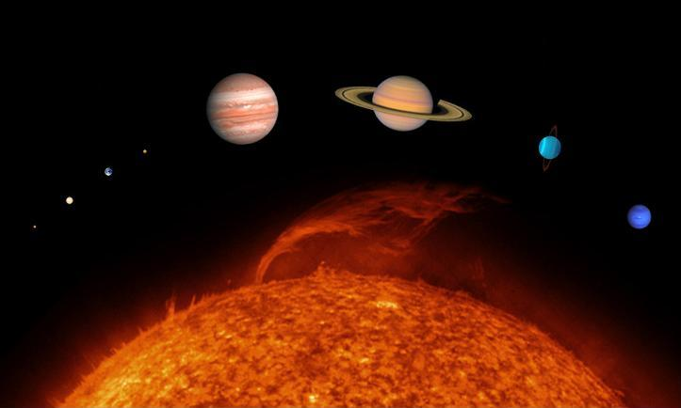
What’s the name of this?
It’s called the Solar System.
____________

