Slide 1
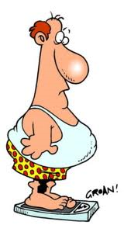
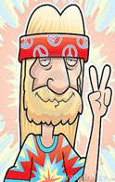
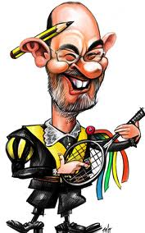
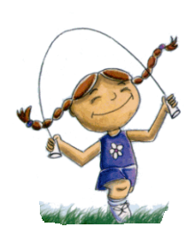
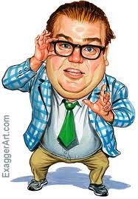
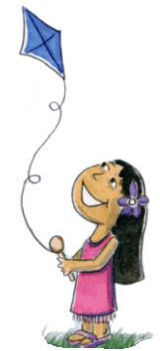
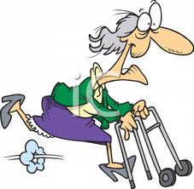
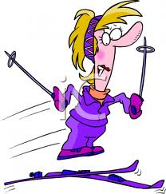
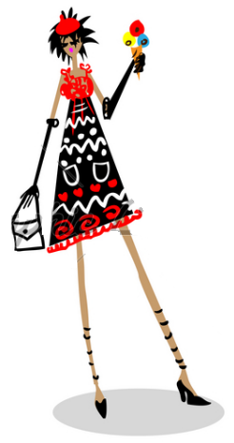
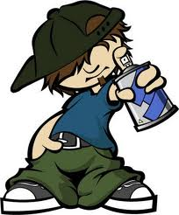
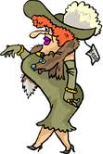
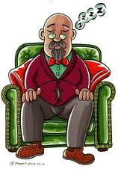
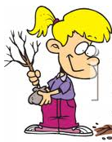
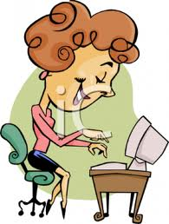
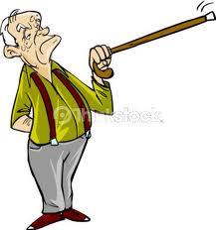
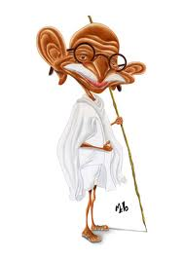
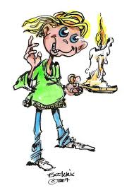
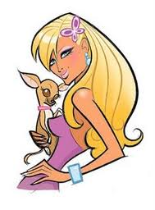
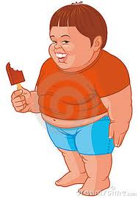
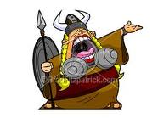
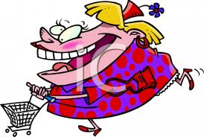
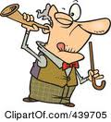
ALEXANDRINO
VANESSA
EDWARD
TERESA
MERKUS
TIARA
ROLAND
ERNESTINA
PAULETTE
DOROTHY
MORTIMER
ANALIA
TINA
JOSH
AMELIA
LINDA
CECILIO
TONY
RANDAL
MIRTA
ANDREA
OLIVERIA
MASTER

Slide 2
INSTRUCTIONS FOR THE TEACHER:
-THIS PPT IS USEFUL FOR PRACTISING PEOPLE´S DESCRIPTIONS (ADJECTIVES, HAVE/HAS GOT,
CAN/CAN´T, ETC)
-YOU CAN USE IT AS A PPT OR PRINT OUT SOME COPIES FOR STUDENTS TO WORK
IN SMALL GROUPS.
ACTIVITY:
-STUDENTS GET IN GROUPS OF 4 OR 5.
-STUDENTS TAKE TURNS CHOOSING 1 CHARACTER OF THE CHART AND WRITE THE NAME
DOWN ON A PIECE OF PAPER (Example: Cecilio).
-THE SELECTION MUST REMAIN SECRET. THE REST OF THE GROUP MUST NOT SEE THAT NAME.
-THE STUDENT WHO CHOOSES THE NAME STARTS GIVING CLUES FOR THE REST TO GUESS WHO
HE OR SHE IS (Example: It´s a he, he isn´t young, he is short, he can´t hear well, etc)
-THE STUDENT OF THE GROUP WHO GUESSES THE RIGHT NAME GETS A POINT.
-THEN, ANOTHER STUDENTS CHOOSES ANOTHER CHARACTER AND DESCRIBES IT.
-THE STUDENTS WHO GETS MORE POINTS WINS.
NOTE: The dotted blue line indicates height (above the line is TALL, below is SHORT)

