Slide 2
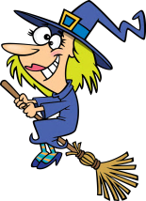
What’s this? How do you spell it?
1/10
t
i
h
c
w
It’s a ...
NEXT
CHECK

Slide 3
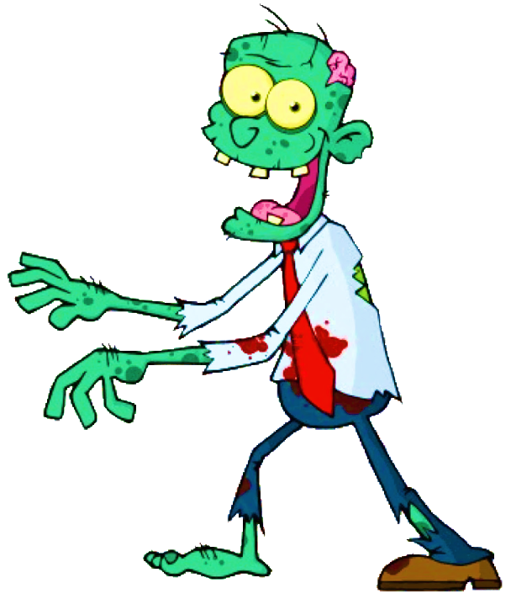
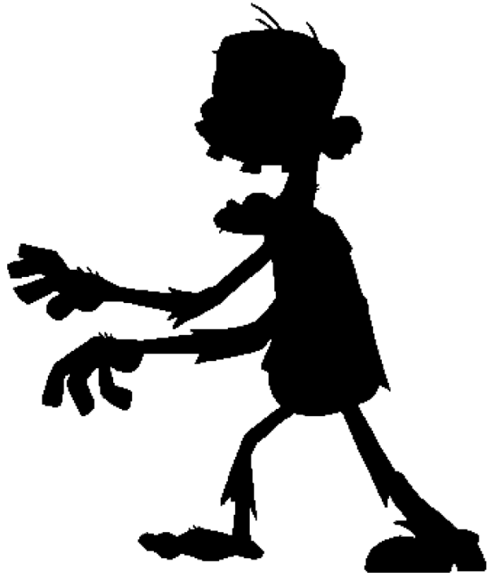
What’s this? How do you spell it?
2/10
m
o
i
b
z
e
It’s a ...
NEXT
CHECK

Slide 4
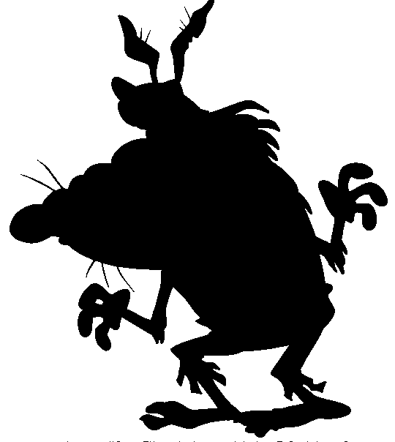
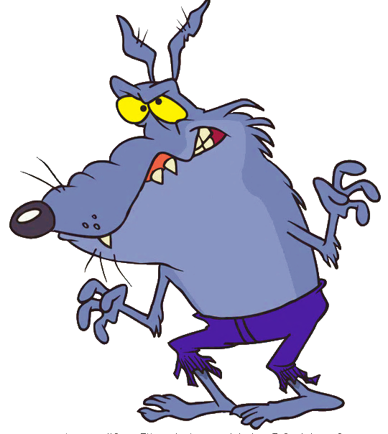
What’s this? How do you spell it?
3/10
r
e
w
e
w
o
f
l
It’s a ...
NEXT
CHECK

Slide 5
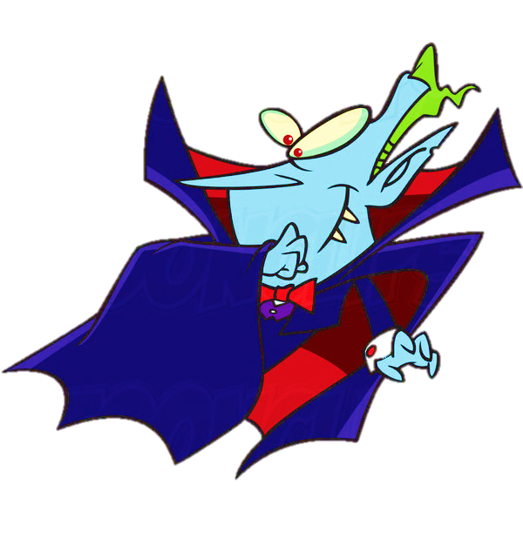
What’s this? How do you spell it?
4/10
m
a
i
p
v
r
e
It’s a ...
NEXT
CHECK

Slide 6
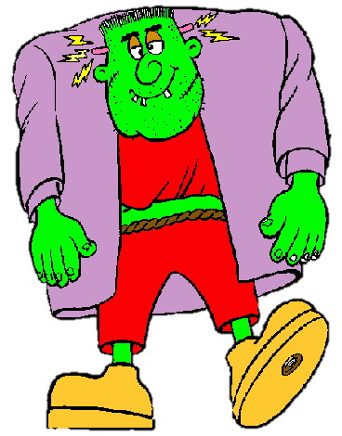
What’s this? How do you spell it?
5/10
n
o
t
s
m
e
r
It’s a ...
NEXT
CHECK

Slide 7
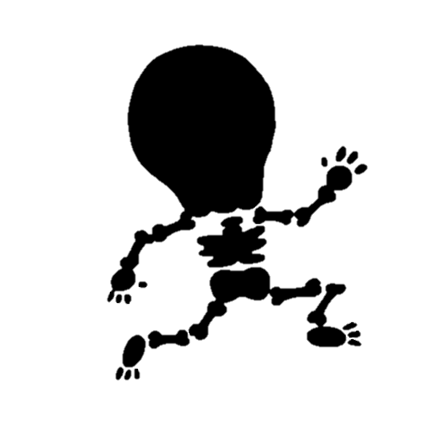
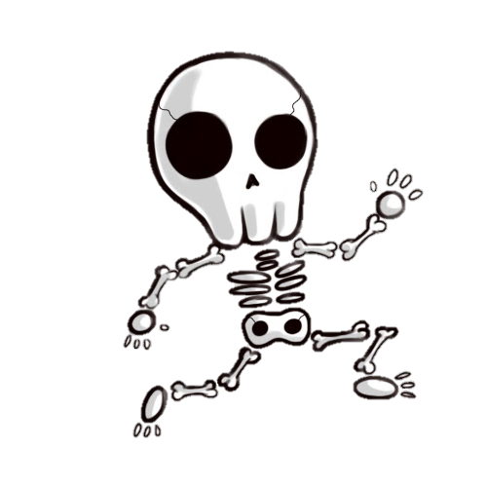
What’s this? How do you spell it?
6/10
e
k
e
l
s
t
n
o
It’s a ...
NEXT
CHECK

Slide 8
What’s this? How do you spell it?
7/10
m
u
y
m
m
It’s a ...
NEXT
CHECK

Slide 9
What’s this? How do you spell it?
8/10
o
h
t
s
g
It’s a ...
NEXT
CHECK

Slide 10
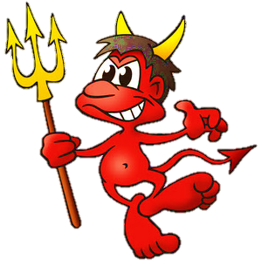
What’s this? How do you spell it?
9/10
v
e
l
i
d
It’s a ...
NEXT
CHECK

Slide 11
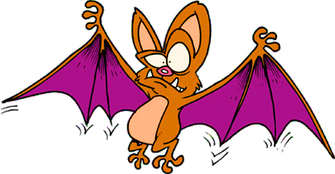
What’s this? How do you spell it?
10/10
a
t
b
It’s a ...
CHECK
EXIT

