Slide 1
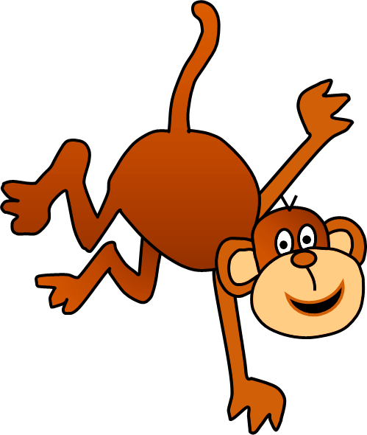
DO - DOES

Slide 2
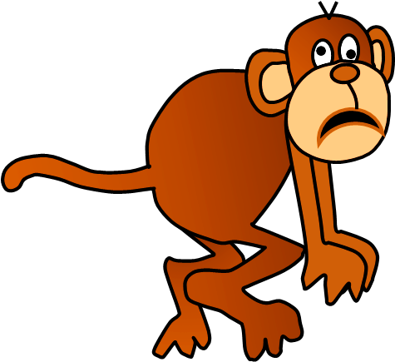
Click on the right option
1/10
THANK YOU!
Do
________ your brothers study at university?
NEXT

Slide 3
2/10
THANK YOU!
does
When ______ he go to the beach?
NEXT

Slide 4
3/10
THANK YOU!
does
What ______ your mother do in the morning?
NEXT

Slide 5
4/10
THANK YOU!
do
When _____ they have lunch?
NEXT

Slide 6
5/10
THANK YOU!
do
Why ______ we have to stay here?
NEXT

Slide 7
6/10
THANK YOU!
Does
________ your sister play voleyball?
NEXT

Slide 8
7/10
THANK YOU!
Does
________ she cook at home?
NEXT

Slide 9
8/10
THANK YOU!
Do
_____ Paul and Ben play the guitar?
NEXT

Slide 10
9/10
THANK YOU!
do
What _____ you do at school?
NEXT

Slide 11
10/10
THANK YOU!
does
How ______ the teacher go to school?
EXIT

