Slide 1
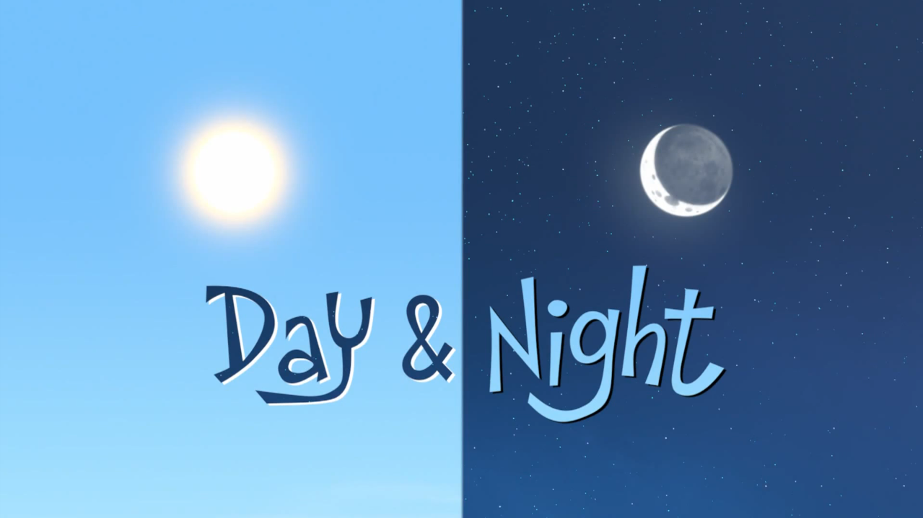
Telling the Time
MR.ARNOLD AGUILAR
Udon Thani Engineering School (UES)

Slide 2
What time is it ?

Slide 3
What time is it ?

Slide 4
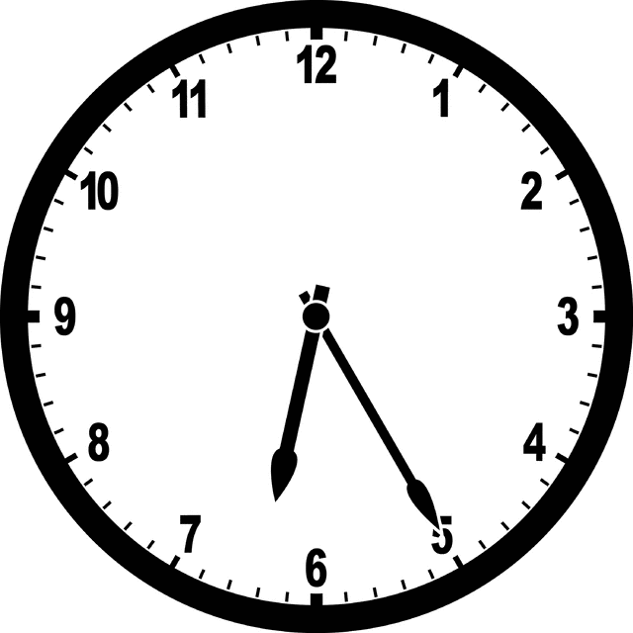
Two common ways of telling the time.
Say the hour first and then the minutes. (Hour + Minutes)
6:25 - It's six twenty-five

Slide 5
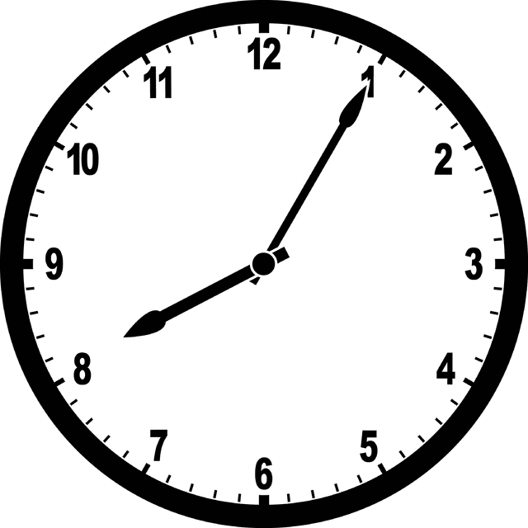
8:05 - It's eight O-five

Slide 6
9:11 - It's nine eleven

Slide 7
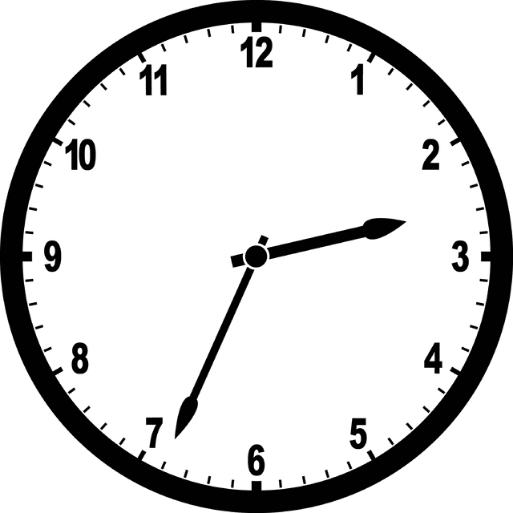
2:34 - It's two thirty-four

Slide 8
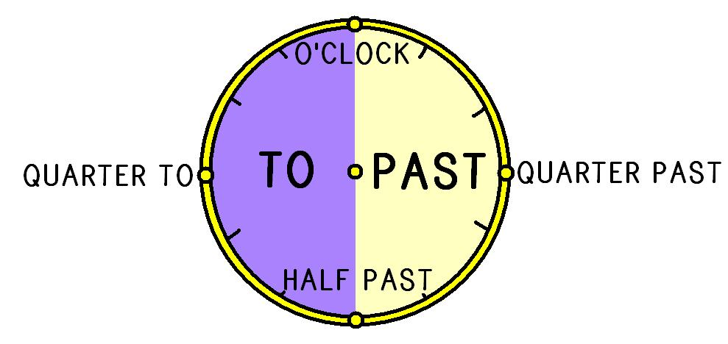
2) Say the minutes first and then the hour. (Minutes + PAST / TO + Hour)
For minutes 1-30 we use PAST after the minutes.
For minutes 31-59 we use TO after the minutes.

Slide 10
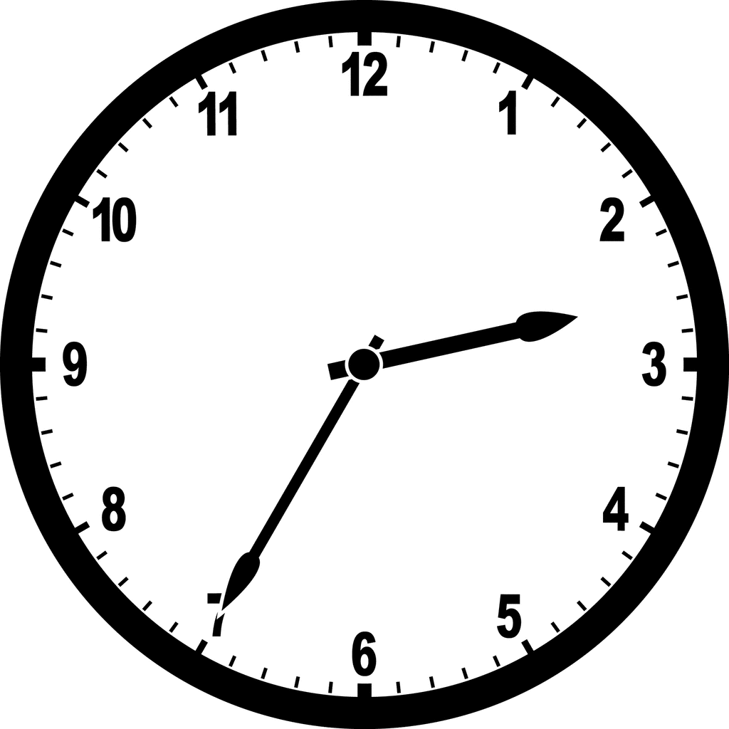
2:35 - It's twenty-five to three

Slide 11
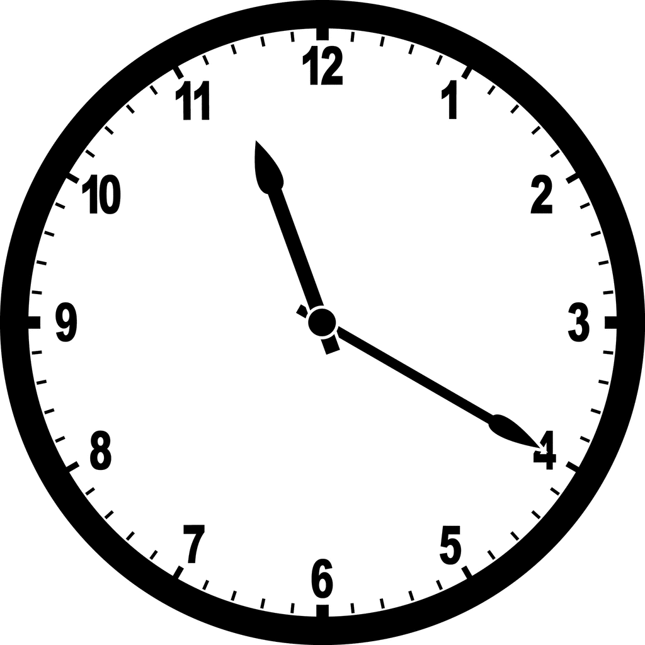
11:20 - It's twenty past eleven

Slide 12
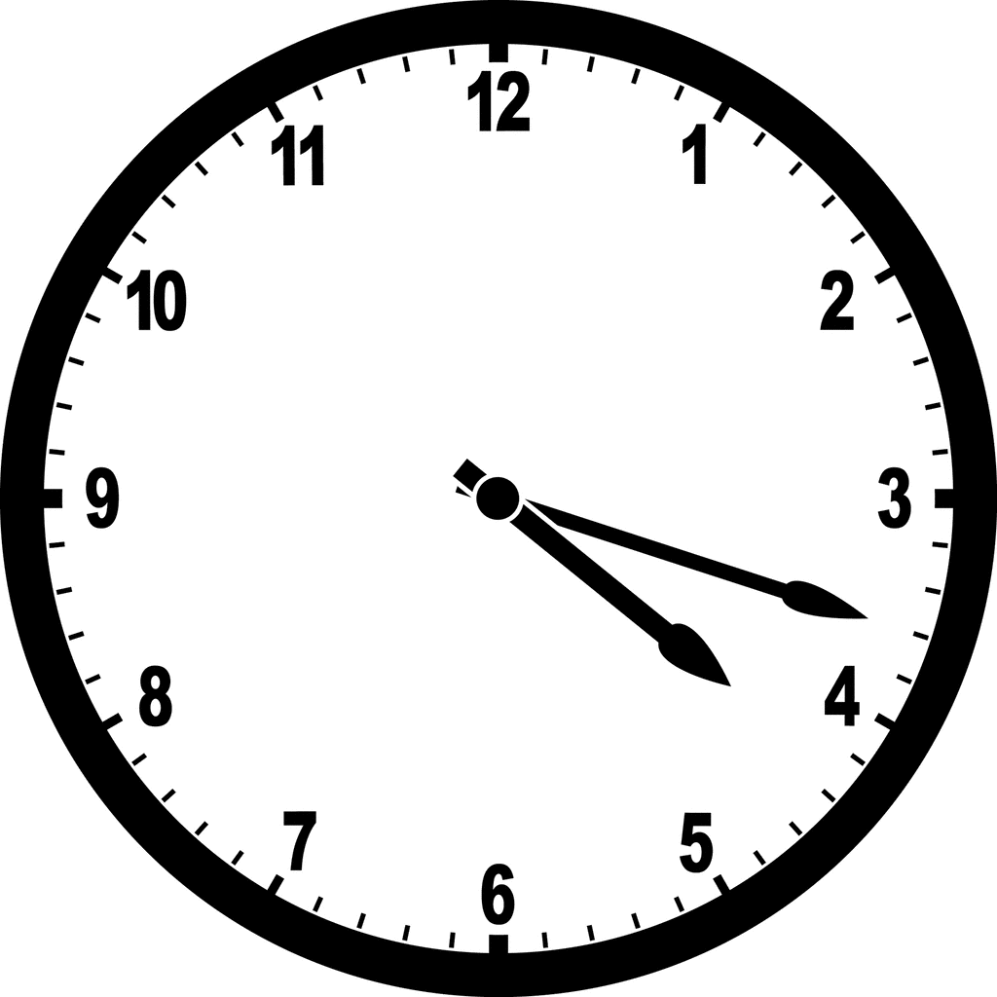
4:18 - It's eighteen past four

Slide 13
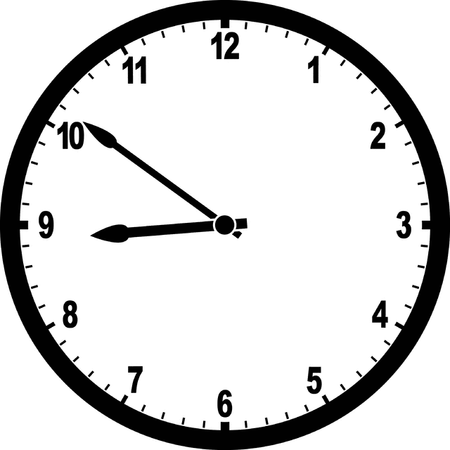
8:51 - It's nine to nine

Slide 14
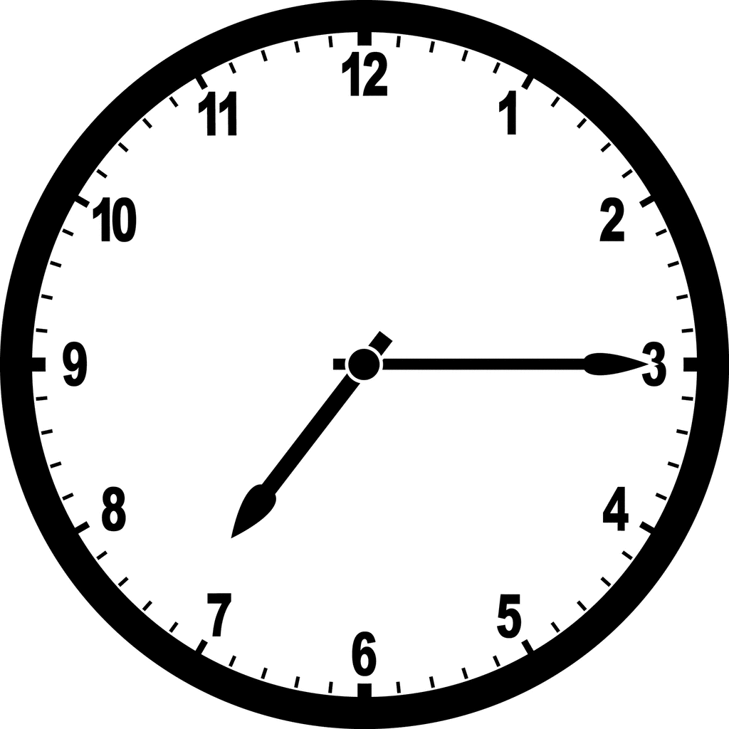
When it is 15 minutes past the hour we normally say: (a) quarter past
7:15 - It's (a) quarter past seven

Slide 15
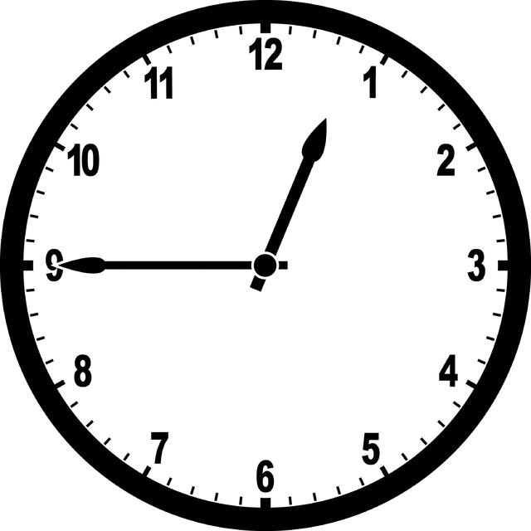
When it is 15 minutes before the hour we normally say: a quarter to
12:45 - It's (a) quarter to one

Slide 16
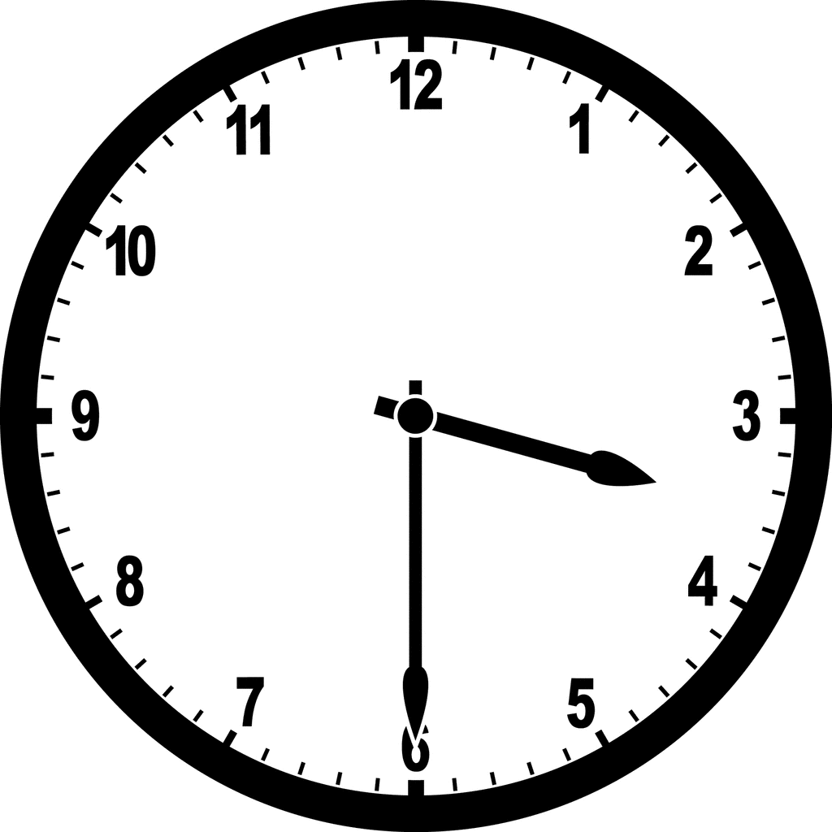
When it is 30 minutes past the hour we normally say: half past
3:30 - It's half past three

Slide 17
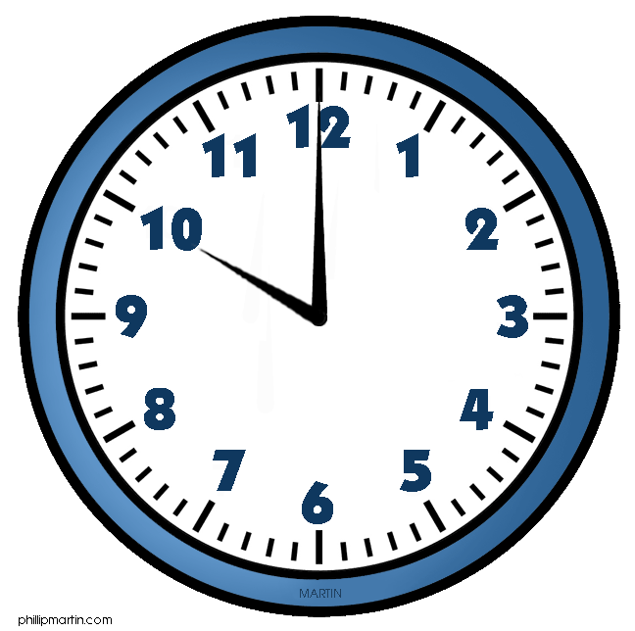
O'clock We use o'clock when there are NO minutes.
10:00 - It's ten o'clock

Slide 18
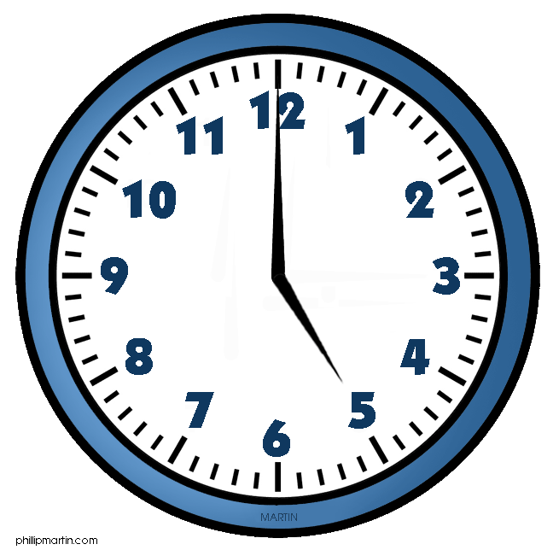
5:00 - It's five o'clock

Slide 19
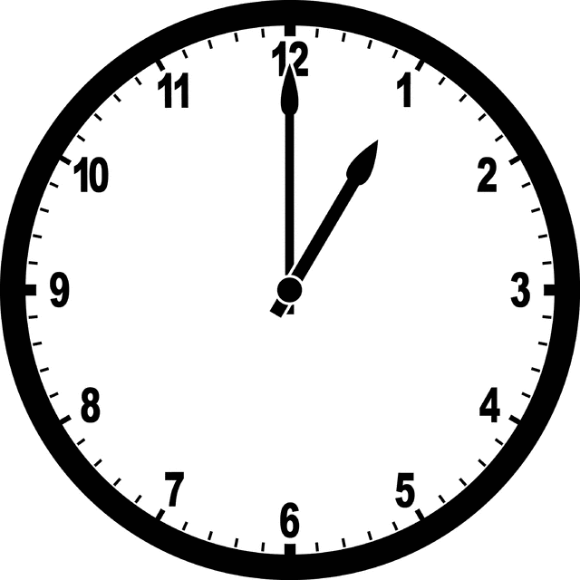
1:00 - It's one o'clock

Slide 20
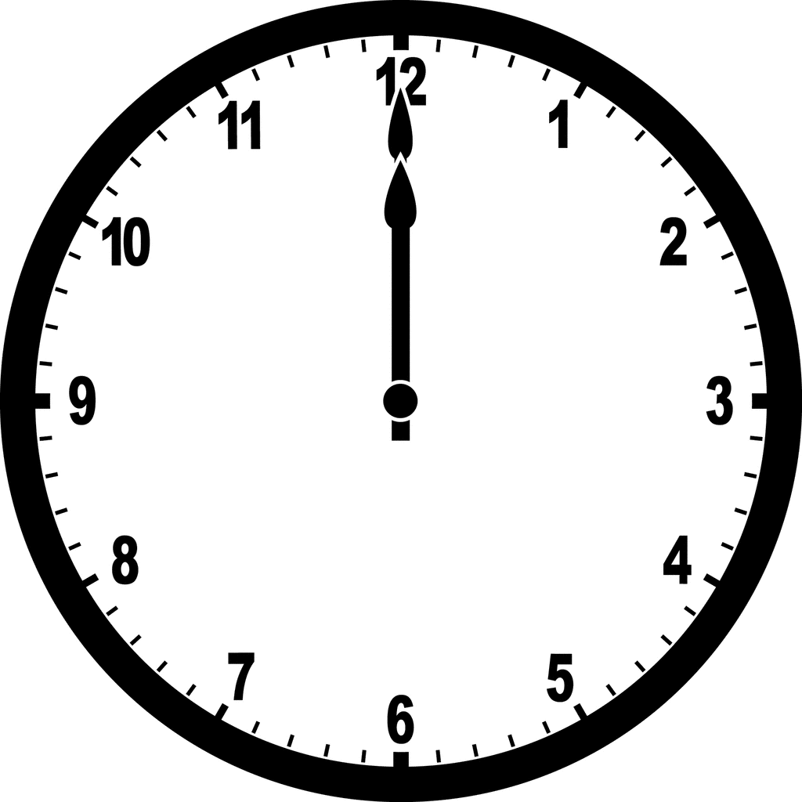
For 12:00 there are four expressions in English.
12:00 ---- It’s twelve o'clock

Slide 21
12:00 midday = noon

Slide 22
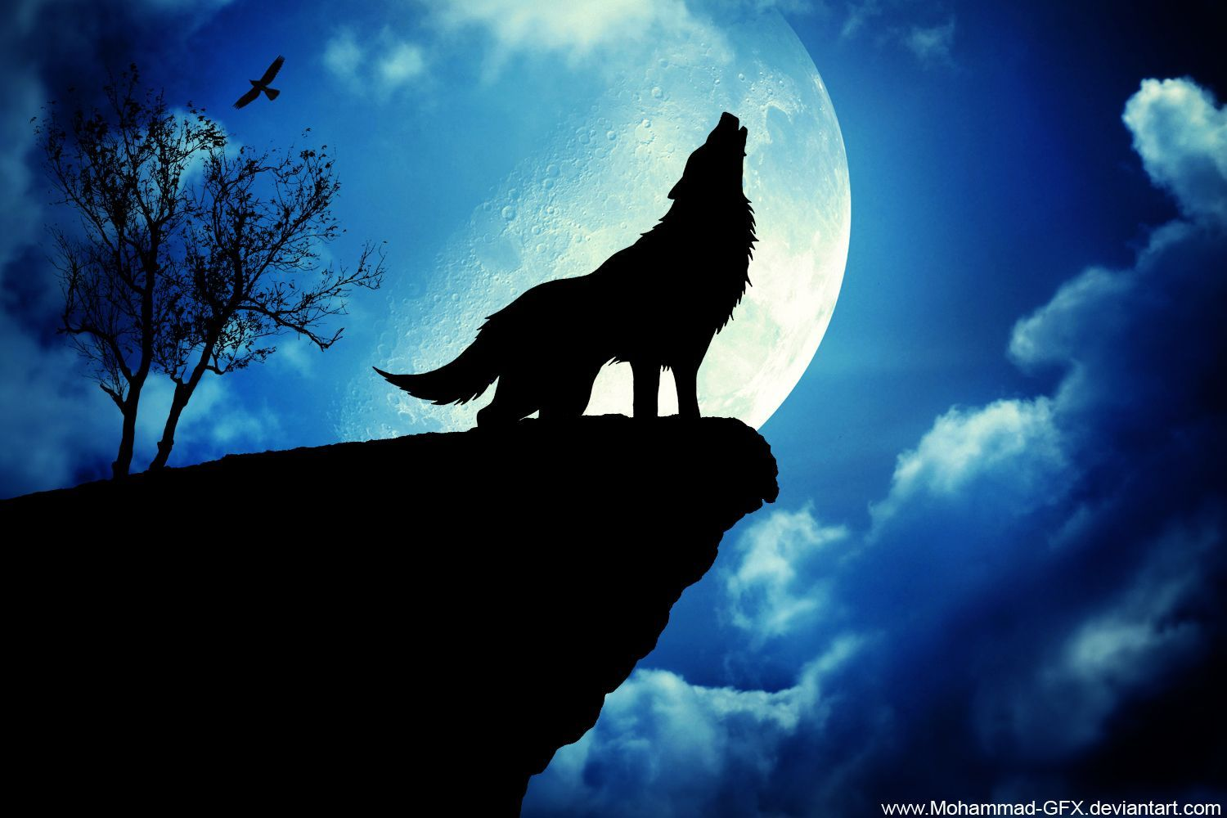
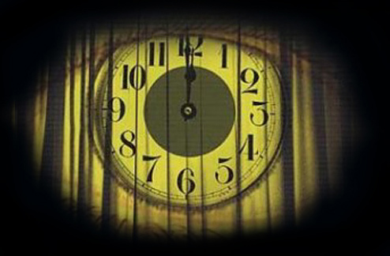
12:00 / 00:00 midnight

Slide 23
WRITE THE TIME
1____________ 2 ____________

Slide 24
3 ______________ 4 ______________

Slide 25
AM vs. PM
We don't normally use the 24-hour clock in English.
We use a.m. (am) for the morning
and p.m. (pm) for the afternoon and night.
a.m. 00:00 – 11:59
p.m. 12:00 – 23:59
3 a.m. = Three o'clock in the morning.
3 p.m. = Three o'clock in the afternoon.

Slide 26
When to use morning,afternoon,evening and night.

Slide 27
Morning is from sunrise to 11:59 AM. Sunrise typically occurs around 6 AM.
Noon or Midday is at 12:00 PM.
Afternoon is from 12:01 PM to around 5:00 PM.
Evening is from 5:01 PM to 8 PM, or around sunset.
Night is from sunset to sunrise, so from 8:01 PM until 5:59 AM.
Midnight is at 12:00 AM.

Slide 28
Writing the time using A.M. or P.M.
Example;
a) 15:30 --- 3:30 p.m.
It’s three thirty in the afternoon.
It’s half past three in the afternoon.
b) 21: 50 --- 9:50 p.m.
It’s nine fifty in the night.
It’s ten to ten in the night.
c) 07: 00 --- 7:00 a.m.
It’s seven o’clock in the morning.

Slide 29
Seatwork: Write the time in 12 hours with AM/PM
1) 12:00 ---
2) 01:30 ---
3) 19: 40 ---
4) 16: 07 ---
5) 08:45 ---

Slide 30
Asking for the Time
The common question forms we use to ask for the time right now are:
1. What time is it?
2. What is the time?
A more polite way to ask for the time, especially from a stranger is:
1.Could you tell me the time please?

Slide 31
Giving the Time
We use It is or It's to respond to the questions that ask for the time right now.
It is half past five (5:30).
It's ten to twelve (11:50)
We use the structure AT + time when giving the time of a specific event.
The bus arrives at midday (12:00).
The flight leaves at a quarter to two (1:45).
The concert begins at ten o'clock. (10:00)

Slide 32
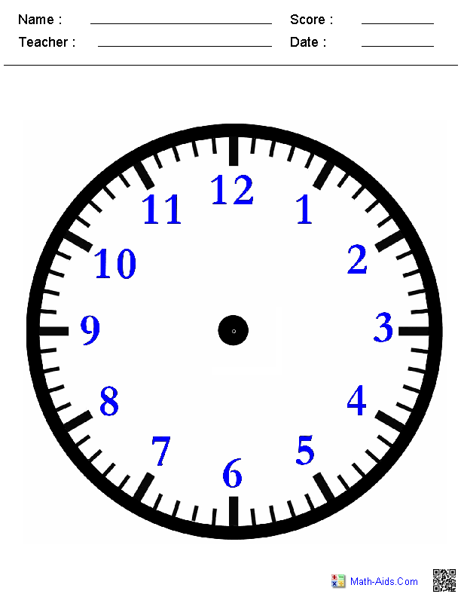
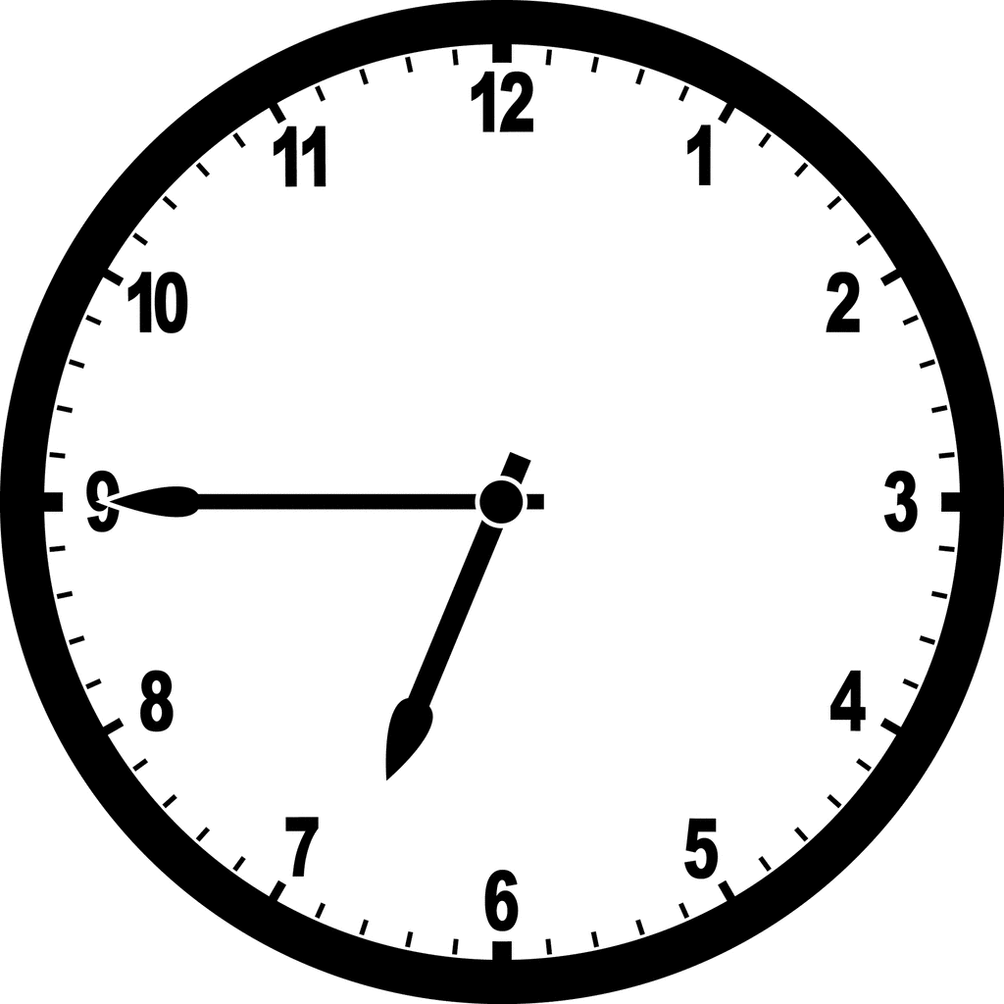
Draw the time.
1. It’s quarter to seven. ( _____:______)

Slide 33
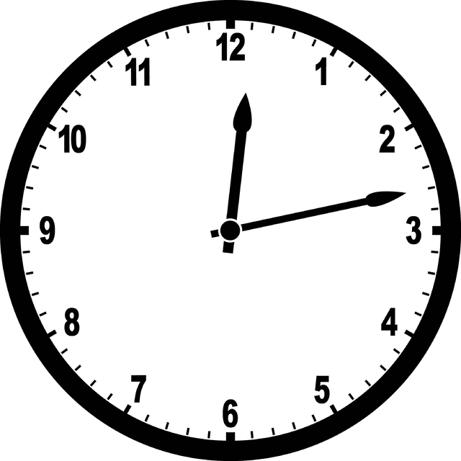
2. It’s thirteen past twelve. (___:____)

Slide 34
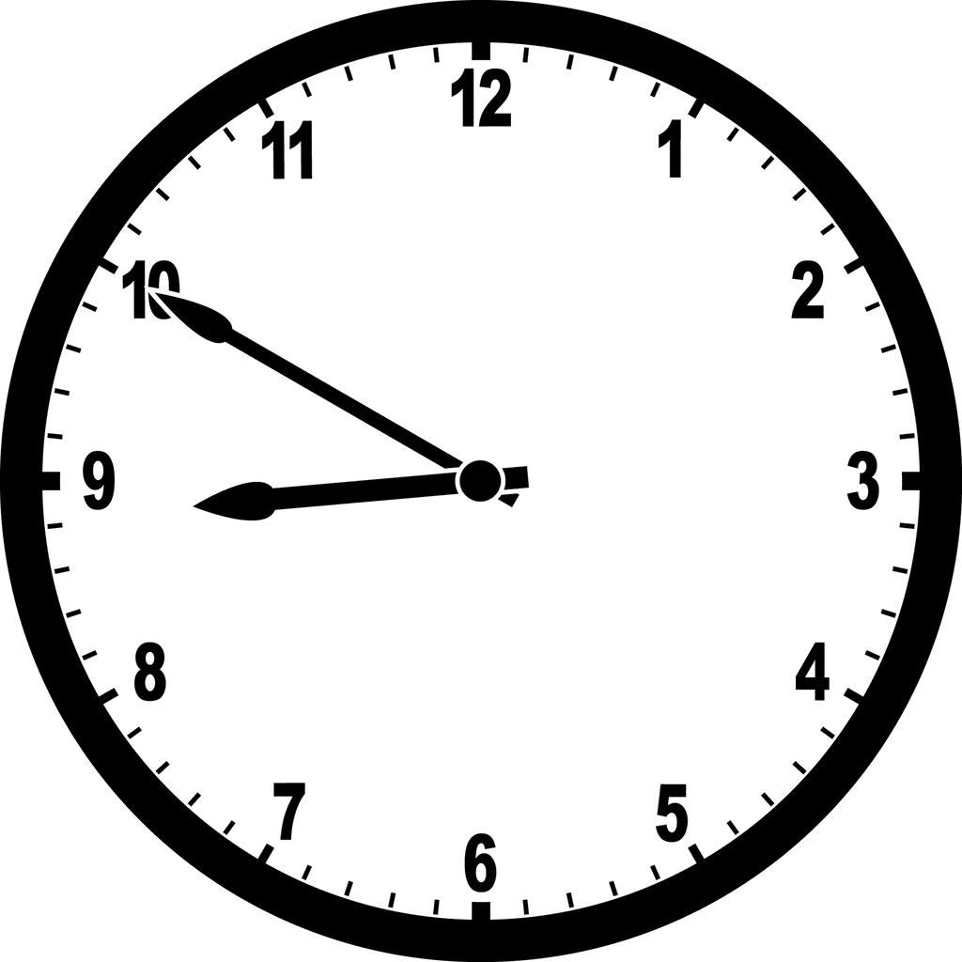
3. It’s ten to nine. (___:____)

Slide 35
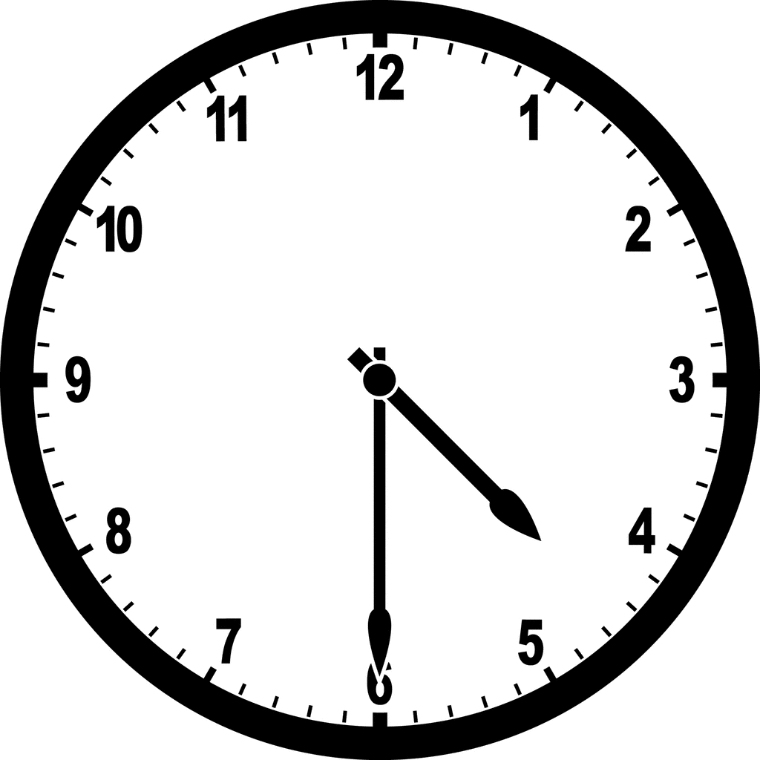
4. It’s half past four. (___:____)

Slide 36
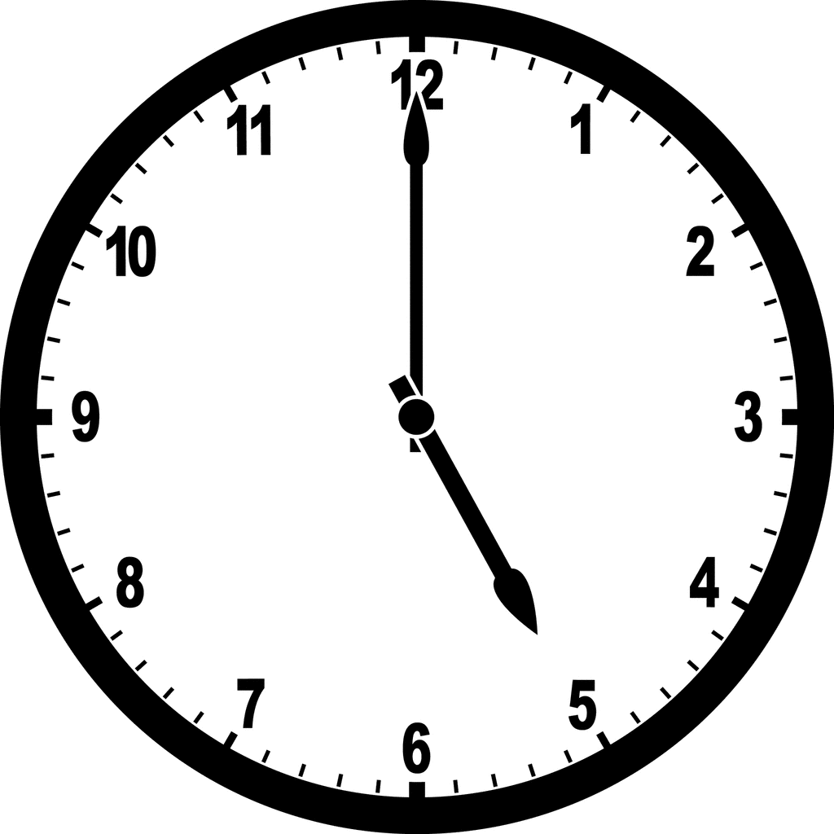
5. It’s five o’clock. (___:____)

Slide 37
Thank You
Everyone…..

