Slide 1
IELTS Listening Matching Questions

Slide 2
Matching
You will see a list of numbered questions (1, 2, 3, etc.) and a list of options labelled with a letter (A, B, C, etc.)
You answer the questions by matching the correct option to each question based on what you hear.
You only need to write the correct letters A, B, C, etc. on the answer sheet.

Slide 3
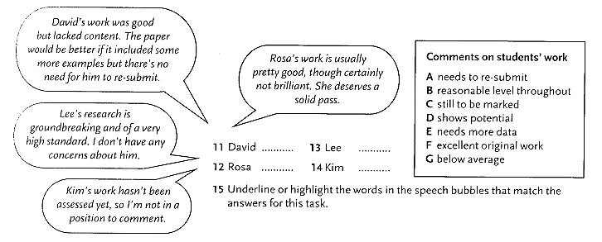
Example
What does the lecturer say about each student?
Choose FOUR answers from the box and write the correct letters A-G
next to the questions 11-14.

Slide 4
Key

Slide 5
Strategies for Matching Questions
Look at the list of numbered questions and decide what they have in common.
Say them quietly to yourself to help you recognize them on the recording.
Read the list of options, noting any heading in the box.
Re-phrase each of the options in your own words.
As you listen, match the options to the questions.

Slide 6
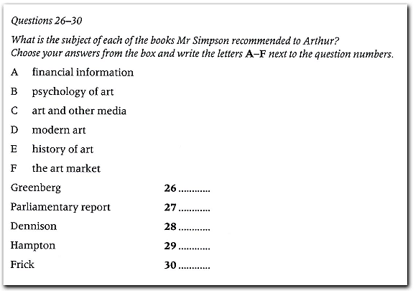
Now try the task

Slide 7
Key

Slide 8
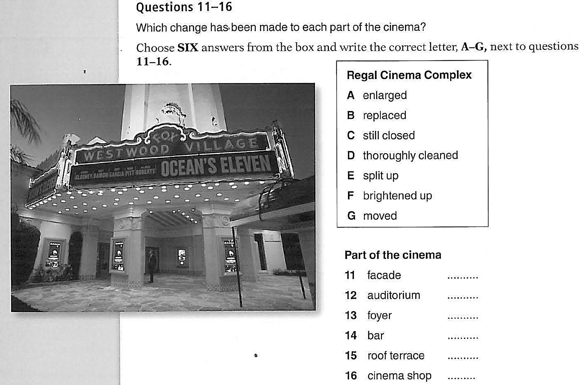

Slide 9
Key

