Slide 1
IELTS Listening Select from a List

Slide 2
Select from a List
You will see a question with a list of possible options.
Your job is to listen to the recording and decide which TWO or THREE of the options correctly answer the question.
You only need to write the correct letters on the answer sheet.
You can put your answers in any order.

Slide 3
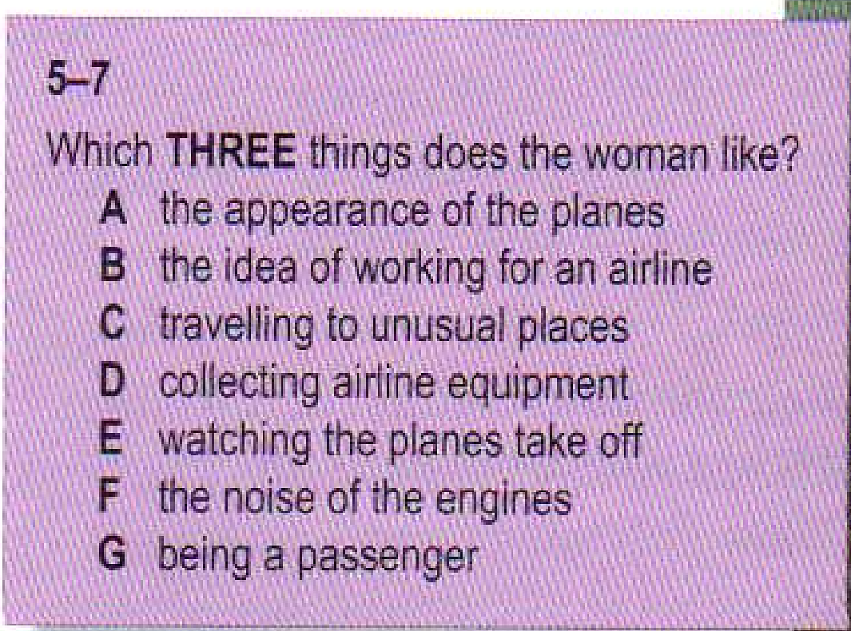
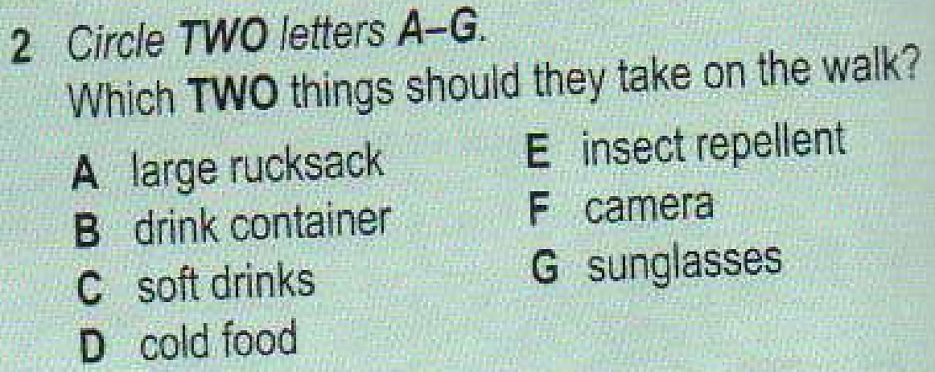
Examples

Slide 4
Tips for Select from a List Questions
This type of questions tests your ability to understand detailed factual information as well as the speaker’s attitude and opinion.
The questions follow the order of the recording while the options come in random order.
When you read the question and the 5 options, you see some words and names that you hear on the reading. These help you know when relevant information is coming.
You may hear one person or two people speaking. When there are two speakers, the question often focuses on what they both say about the topic, and whether they agree or not.

Slide 5
Tips for Select from a List Questions
The Common Distractor – Changing Opinions
You may hear most or all of the options on the recording. Don’t just select the first words you hear. Speakers may change their minds, so you cannot answer the questions with certainty until the discussion is finished.

Slide 7
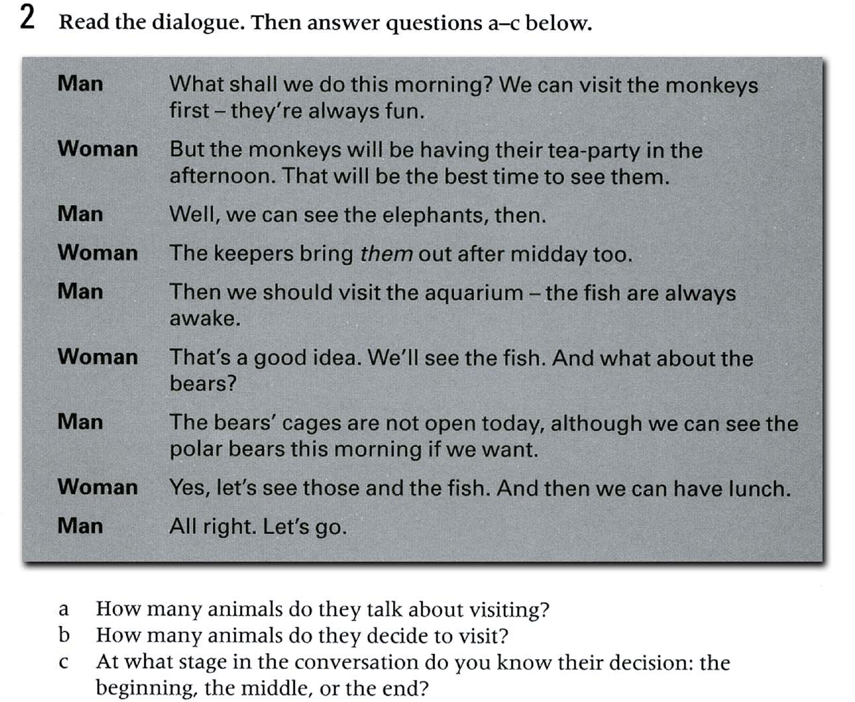

Slide 8
Strategies for Select from a list Questions
Read the question carefully and note how many options you must pick.
Underline the key words in the main questions and predict what the topic is and who the speaker(s) might be.
Read the list of options and underline any key words.
Re-phrase the options in your own words (if possible).
As you listen, choose the correct answers.

Slide 9
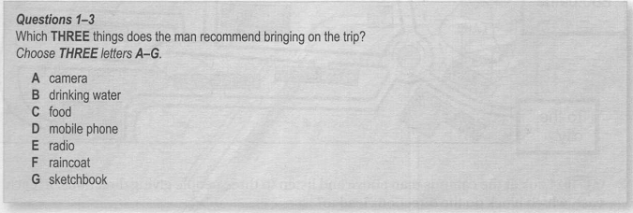
Now try the task

Slide 10
Key
D, F, G (in any order)

Slide 11
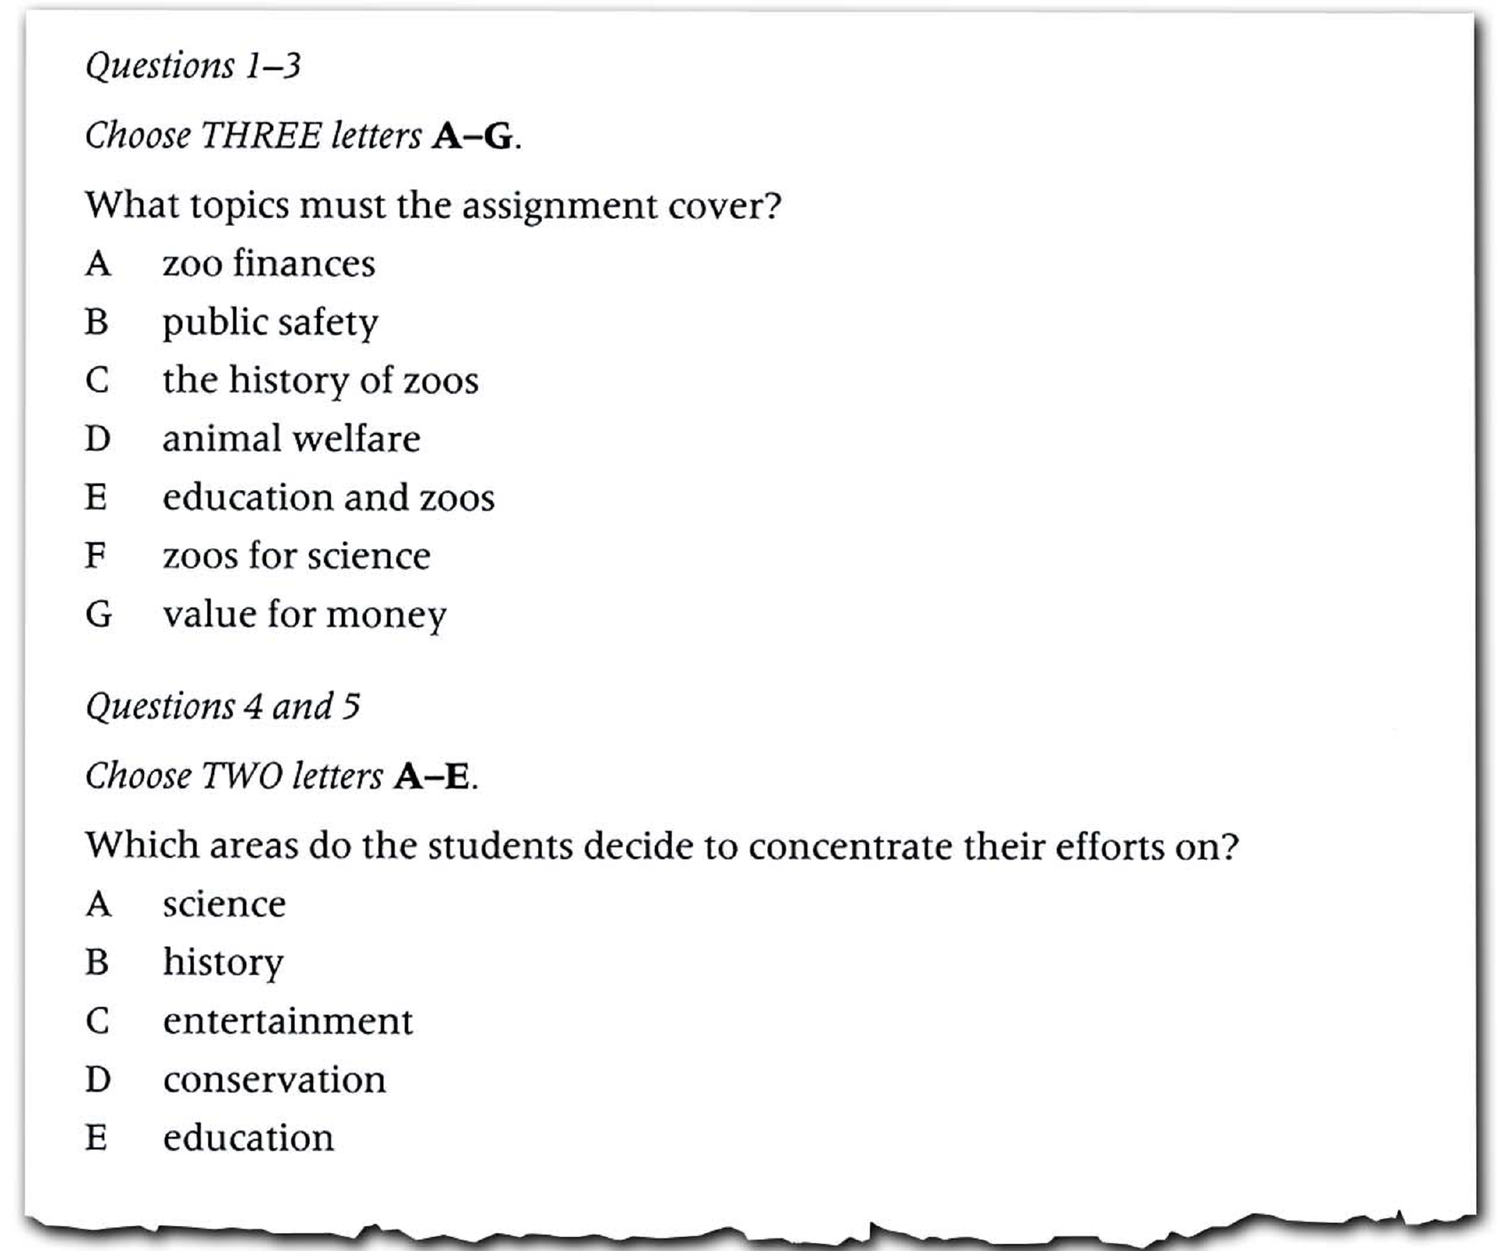

Slide 12
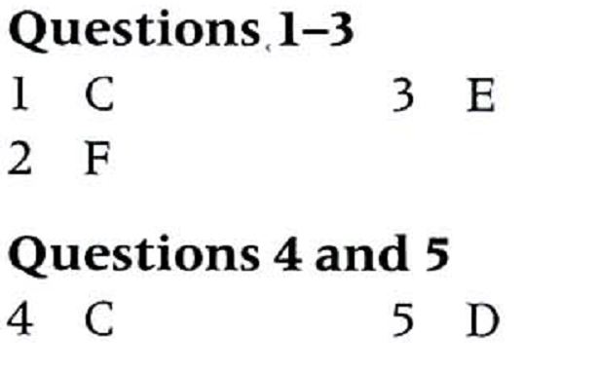
Key

