Slide 1
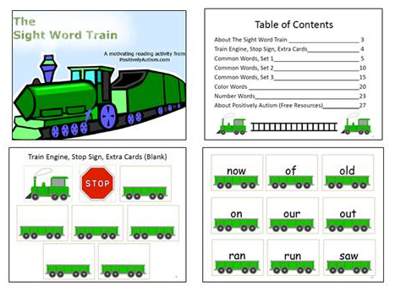
Advertisement – Help Keep Positively Autism’s Resources Free
The Sight Word Train
A Motivating Reading Activity

Slide 2
Waiting While Riding in the Car
This story begins on the following page. Before using, please read the notes for parents on the last page. Thank you.

Slide 3
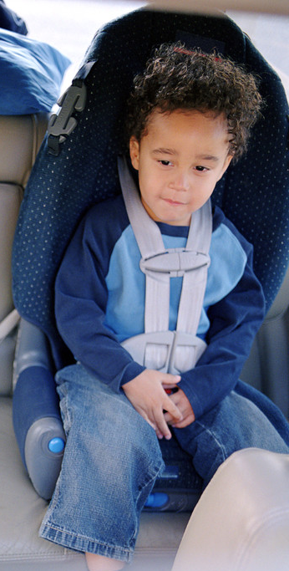
Waiting While Riding in the Car

Slide 4
Insert picture of your child or student here.
My name is _________________.

Slide 5
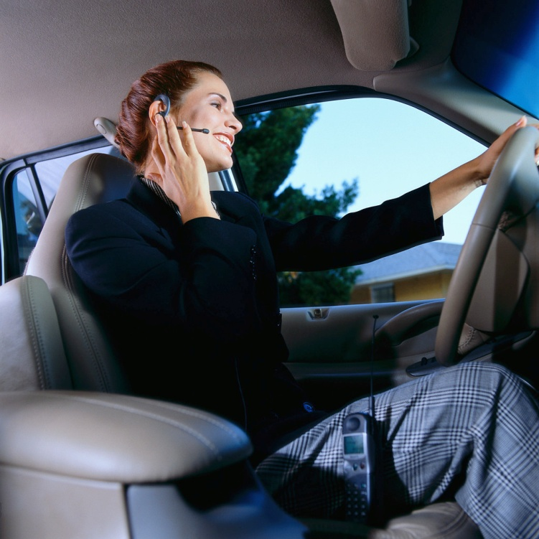
Sometimes, I ride in the car with my mom or dad.

Slide 6
The car is moving most of the time.
But sometimes, we have to stop and wait.

Slide 7
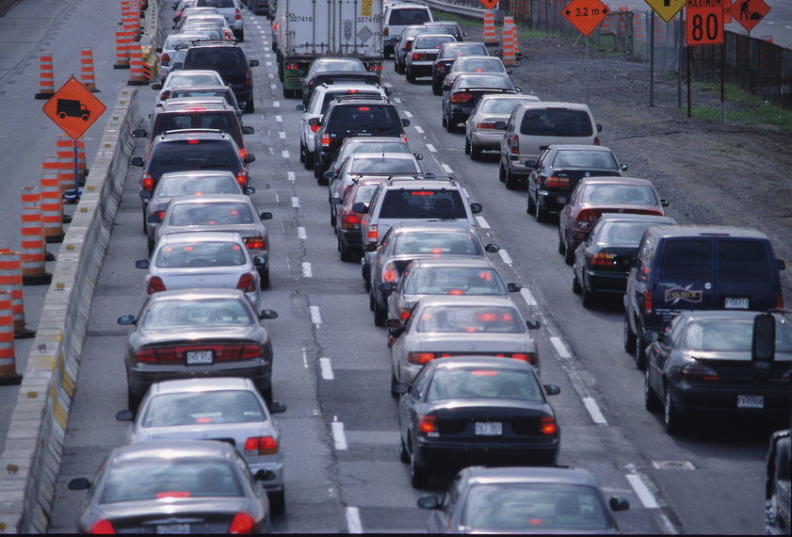
There might be lots of cars on the road.
This is called a traffic jam or being stuck in traffic.

Slide 8

A traffic jam means that there is not enough room for all of the cars to drive fast. We drive slowly so that we can share the road with other cars.

Slide 9


Another time we stop and wait in the car is at a stop sign or red light.

Slide 10
At a stop sign or red light, the cars take turns driving.
My mom or dad knows when it is our turn to drive.

Slide 11
Another time we wait in the car is if there is road construction.

Slide 12
Road construction means that people are fixing something on the road.

Slide 13
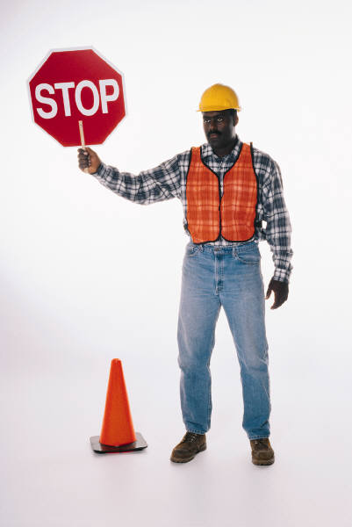
Cars have to slow down or stop to drive by the road construction workers and vehicles.

Slide 14
I will try to be patient while I wait in the car.
I can read, listen to music, or draw while I wait.

Slide 15
I am learning about waiting while riding in the car.

Slide 16
Notes for Parents/Teachers
It is best to customize this story for each individual child by incorporating the child’s name and photos and altering any words and pictures to best meet your child’s learning needs and preferences.
The term Social StoriesTM is trademarked by Carol Gray. Every effort has been made to write this story according to Carol Gray’s guidelines, but no guarantee can be made. Carol Gray has not specifically endorsed this story. For more information about writing Social StoriesTM , please read:
The New Social Story Book, Revised and Expanded 10th Anniversary Edition: Over 150 Social Stories that Teach Everyday Social Skills to Children with Autism or Asperger's Syndrome, and their Peers

